Slide 1
Impact of Studying on Understanding Everyday Conversations in Tagalog
Izzy Mika - Data Science 211

Slide 2
How does studying daily affect how much I can understand from casual conversations?
Background: I’m a beginner learning Tagalog and am interested in whether studying daily is improving my ability to understand street language.

Slide 3
Question: After studying daily for 2 weeks, will I understand more words than not?
Definitions:
Studying: studying Tagalog for 20 minutes every day (via LearningTagalog)
Casual conversation: Street interviews on the EasyFilipino YouTube channel
Is the proportion of words I understand significantly higher than the proportion of words I don’t?
Is there a measurable improvement over time in the percentage of words I understand from street interviews?

Slide 4
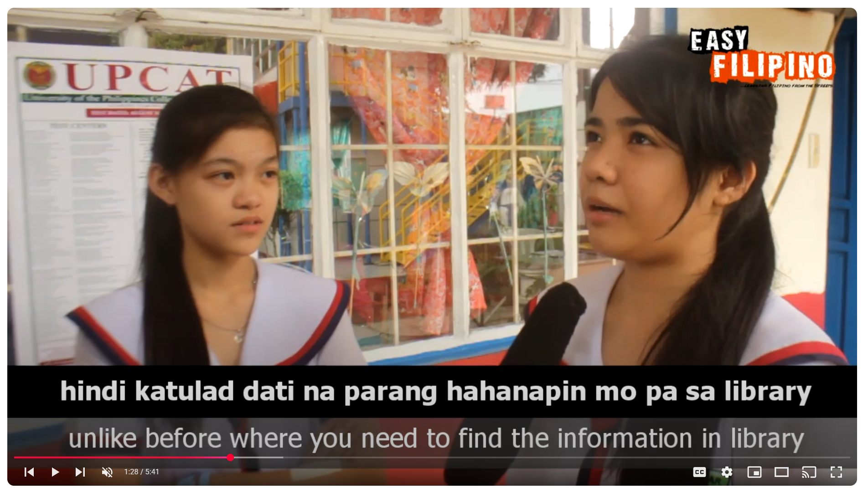
Data
Observations: 1,114 words encountered (from 10 sentences per day for 11 days*)
* Studied and tested over 14 days; but had to remove three days because the folks interviewed in one of the EasyFilipino videos were mostly speaking in Binisay, not Tagalog.

Slide 5
Data
Variables:
Independent: How many days I’ve been studying over time (20 min every day)
Dependent: % words understood per day (self-report) when listening to 10 full sentences from Easy Filipino interview video*
  *excluding sentences with <4 words to exclude sentence fragments and fixed phrases (e.g “at the airport.” or “no thanks.”)
  *excluding proper nouns; English/other language words (“maneho” and “mag-drive” are okay, but “iphone” or “summa cum laude” are not)
  *excluding most function words (e/g words similar to ‘the’ and ‘at’ etc. like mga, sa) (extremely common / reducing noise).

Slide 6
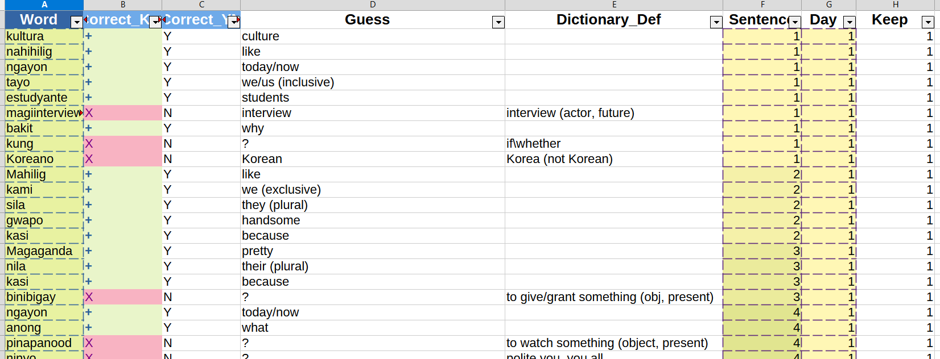
Dataset

Slide 7
Hypothesis Testing
Define hypotheses:
H₀: P_{Y} = P_{N}
H_{a}: P_{Y} > P_{N}
P_{Y} - Proportion of correct answers (“Y”)
P_{N} - Proportion of incorrect answers (“N”)
Notes:
Null Hypothesis:
P(correct) = P(wrong). No difference between words understood and not.
Alternative Hypothesis:
P(correct) > P(wrong). More words understood than not.

Slide 8
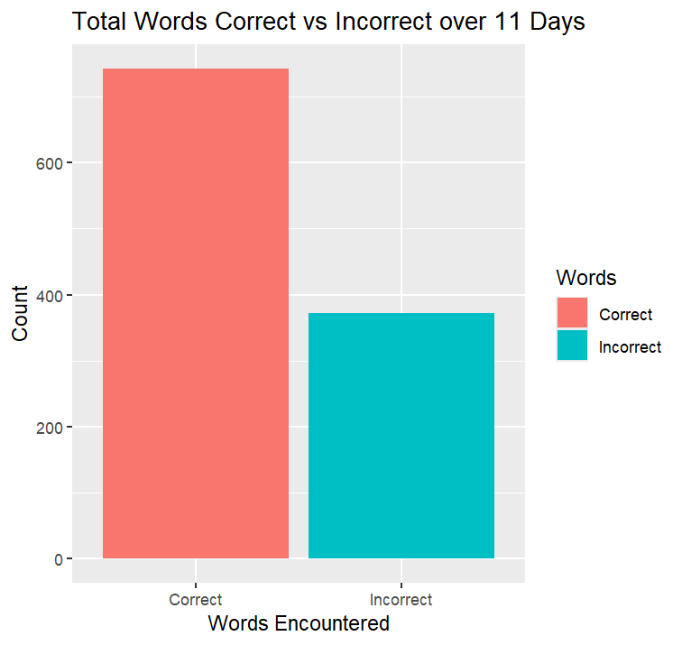
Hypothesis Testing
2) Test hypothesis: Is the proportion of words correct greater than incorrect?
Visually, the words correct is twice as large as the words incorrect
742 words correct versus 372 words incorrect

Slide 9
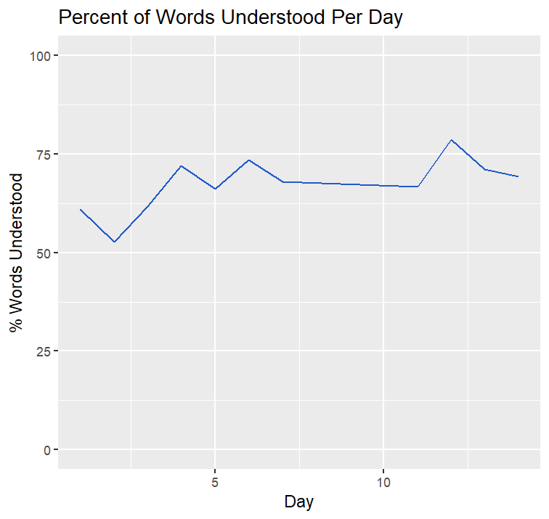
Hypothesis Testing
2) Test hypothesis: Is the proportion of words correct greater than incorrect?
Line chart shows mild positive trend over time
Day 1: 61%
Day 14: 69%
Notes:
Answering: Is there a measurable improvement over time in the percentage of words I understand from street interviews?

Slide 10
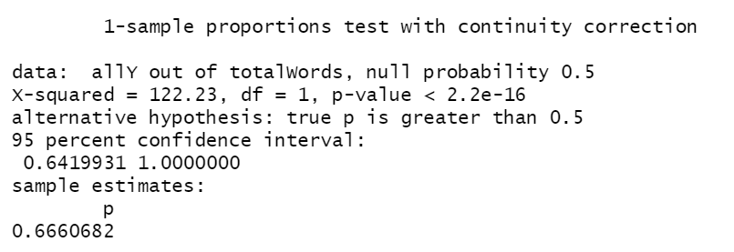
Hypothesis Testing
2) Test hypothesis: Is the proportion of words correct greater than incorrect?
Using a prop test:
p-value = 2.2e⁻¹⁶ < 0.05
The p-value is far less 𝛼 = 0.05, so we reject the null hypothesis H₀ : P_{Y} = P_{N}
in favor of the alternative hypothesis, H_{a} : P_{Y} > P_{N.}
Notes:
1-sample proportions test with continuity correction
data: allY out of totalWords, null probability 0.5
X-squared = 122.23, df = 1, p-value < 2.2e-16
alternative hypothesis: true p is greater than 0.5
95 percent confidence interval:
0.6419931 1.0000000
sample estimates:
p
0.6660682

Slide 11
Conclusion
Using the results of the prop test, we can reject the null hypothesis in favor of the alternative, which is that I understood more words than I missed over time.
There is some additional evidence to support the alternative, e.g. the mild positive trend over time, but more data points are needed to convincingly argue that studying caused me to understand more words!
The improvement would likely be greater if the method & target were more specific. LearningTagalog focuses on teaching core vocab & grammar from the start, but many content words in the EasyFilipino video series are specific to a topic.
Github Repository: https://github.com/izzyvmika/DSProject_StudyingTagalog/tree/main
Notes:
Caveats:
I had to throw out 3 days of data
Word frequency is not truly random

